Slide 1

PLC PROGRAMMING
Information subject: 3 credits (45h)
Midterm Exam : Practice exercises
Final Exam : Projects
Lecturer : Msc. Pham Hai Yen
Phone number : 0946336688
PLC Programming 1. AN INTRODUCTION TO PROGRAMABLE LOGIC CONTROLLERS

Slide 2
What are some common examples of control?
Washing machine, sump pump, microwave, ….
Others?
PLC Programming 1. AN INTRODUCTION TO PROGRAMABLE LOGIC CONTROLLERS

Slide 3
WHAT IS CONTROL SYSTEM?
A control system manages, commands, directs, or regulates the behavior of other devices or systems using control loops. It can range from a single home heating controller using a thermostat controlling a domestic boiler to large industrial control systems which are used for controlling processes or machines. The control systems are designed via control engineering process
For continuously modulated control, a feedback controller is used to automatically control a process or operation. The control system compares the value or status of the process variable (PV) being controlled with the desired value or setpoint (SP), and applies the difference as a control signal to bring the process variable output of the plant to the same value as the setpoint.
PLC Programming 1. AN INTRODUCTION TO PROGRAMABLE LOGIC CONTROLLER
Notes:
For sequential and combinational logic, software logic, such as in a programmable logic controller, is used.

Slide 4
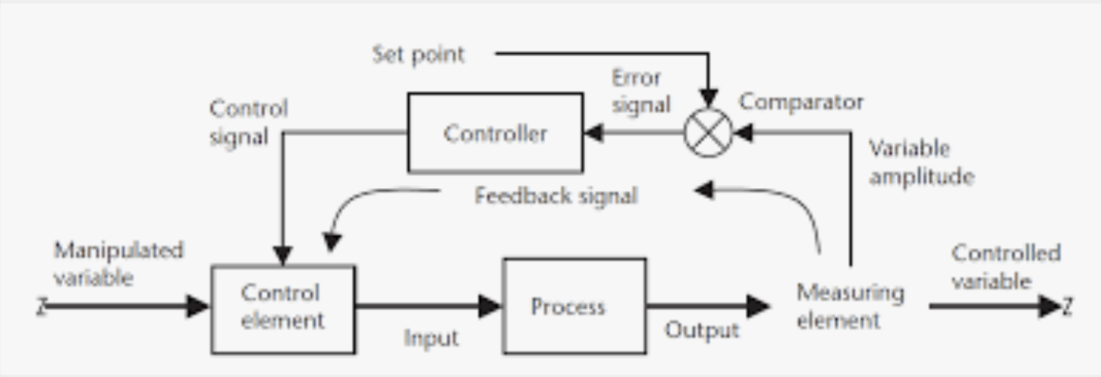
1. Control System is..
Components that connected to system or process that want to be controlled.
5 basic elements of control system:
i. Reference signal generator
ii. Measurement element
iii. Comparator
iv. Controller
v. Actuator
PLC Programming 1. AN INTRODUCTION TO PROGRAMABLE LOGIC CONTROLLERS
Notes:
Fundamentally, there are two types of control loop: open-loop control (feedforward), and closed-loop control (feedback).

Slide 5
1.1 OPEN LOOP CONTROL SYSTEM:
Output does not affect the function of the entire system.
System
Reference input
Controller
Actuator
Output signal
Fig. 1: Block diagram of Open loop control system
PLC Programming 1. AN INTRODUCTION TO PROGRAMABLE LOGIC CONTROLLERS
Notes:
In open-loop control, the control action from the controller is independent of the "process output" (or "controlled process variable"). A good example of this is a central heating boiler controlled only by a timer, so that heat is applied for a constant time, regardless of the temperature of the building. The control action is the switching on/off of the boiler, but the controlled variable should be the building temperature, but is not because this is open-loop control of the boiler, which does not give closed-loop control of the temperature.

Slide 6
1.1 EXAMPLE : Street Lighting System
Commonly a system that using timer.
ON and OFF at specific time
( Night = ON and Day = OFF)
Duration within ON and OFF is set up bytimer.
System
(street lighting system)
Time set up
Controller
(timer)
Actuator
(Relay)
Street Lamp ON @ OFF
Fig. 2: Block diagram of Street Lighting System using Open loop control system
PLC Programming 1. AN INTRODUCTION TO PROGRAMABLE LOGIC CONTROLLERS

Slide 7
1.2 CLOSED LOOP CONTROL SYSTEM
Also known as Feedback Control System
System Output affect the control function of the entire system.
comparator
System
Reference input
controller
Actuator
Output signal
Measurement element
Fig. 3: Block Diagram of Closed Loop System
PLC Programming 1. AN INTRODUCTION TO PROGRAMABLE LOGIC CONTROLLERS
Notes:
In closed loop control, the control action from the controller is dependent on the process output. In the case of the boiler analogy, this would include a thermostat to monitor the building temperature, and thereby feed back a signal to ensure the controller maintains the building at the temperature set on the thermostat. A closed loop controller therefore has a feedback loop which ensures the controller exerts a control action to give a process output the same as the "reference input" or "set point". For this reason, closed loop controllers are also called feedback controllers.^{[1]}

Slide 8
1.2 EXAMPLE : STREET LIGHTING SYSTEM
Commonly a system that using sensor as input element.
ON and OFF automatically as the light sensor detect the light
regardless of the particular time.
Dark = ON and Bright = OFF)
comparator
System
(street lighting system)
Reference input
(Light intensity)
controller
Actuator
(relay)
Output signal
(lamp ON@OFF)
Measurement element
(light sensor)
PLC Programming 1. AN INTRODUCTION TO PROGRAMABLE LOGIC CONTROLLERS

Slide 9
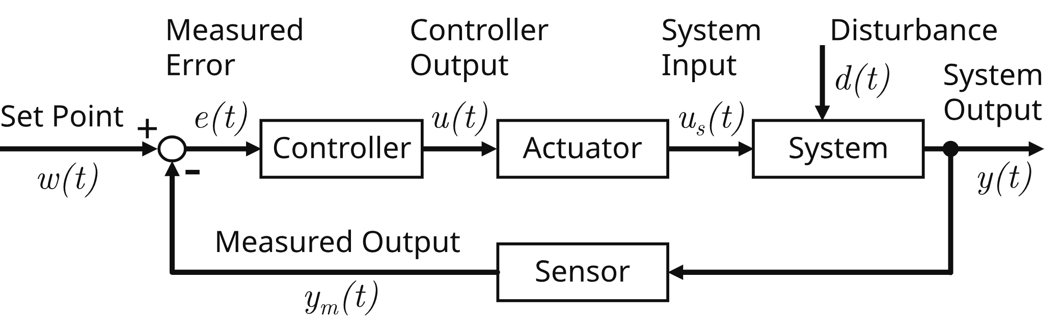
1.3 COMPUTERISED CONTROL SYSTEM
A control system that use a computer as a controller.
This system can be represented by the block diagram as in figure 5.
Fig. 5: Block Diagram of Closed Loop System
PLC Programming 1. AN INTRODUCTION TO PROGRAMABLE LOGIC CONTROLLERS
Notes:
In the case of linear feedback systems, a control loop including sensors, control algorithms, and actuators is arranged in an attempt to regulate a variable at a setpoint (SP). An everyday example is the cruise control on a road vehicle; where external influences such as hills would cause speed changes, and the driver has the ability to alter the desired set speed. The PID algorithm in the controller restores the actual speed to the desired speed in an optimum way, with minimal delay or overshoot, by controlling the power output of the vehicle's engine. Control systems that include some sensing of the results they are trying to achieve are making use of feedback and can adapt to varying circumstances to some extent. Open-loop control systems do not make use of feedback, and run only in pre-arranged ways.

Slide 10
6. COMPARISON
Open Loop System (OLS) | Close Loop System (CLS)
Easy to design | The design is complicated or Complex.
The accuracy depends on the calibration elements | The system is very accurate.
less instability problem. | problems of instability.
Unable to reduce the impact of non-linearity. | Non-linearity effects can be minimized.
PLC Programming 1. AN INTRODUCTION TO PROGRAMABLE LOGIC CONTROLLERS
Notes:
Closed-loop controllers have the following advantages over open-loop controllers:
disturbance rejection (such as hills in the cruise control example above)
guaranteed performance even with model uncertainties, when the model structure does not match perfectly the real process and the model parameters are not exact
unstable processes can be stabilized
reduced sensitivity to parameter variations
improved reference tracking performance
improved rectification of random fluctuations^{[5]}
In some systems, closed-loop and open-loop control are used simultaneously. In such systems, the open-loop control is termed feedforward and serves to further improve reference tracking performance.

Slide 11
2. REFERENCE INPUT:
Is a signal to start a system.
Ex: such as temperature, pressure and level.
Fix value.
3. CONTROLLED VARIABLE:
Is a signal or variable that is controlled at its output.
Ex: Temperature, pressure and level.
Fix value.
4. DISTURBANCE:
Element that disturb a control signal in control system.
Can be from within the system itself or external.
5. FEEDBACK ELEMENT
Element that use to send output signal to be compared with input signal by comparator in closed loop system.
PLC Programming 1. AN INTRODUCTION TO PROGRAMABLE LOGIC CONTROLLERS

Slide 12
INTRODUCTION TO PLC
II. Explain PLC
II.1.1 Define PLC terminologies
II.1.2 Explain PLC background
II.1.3 Explain PLC functions
II.1.4 List and explain the types and advantages of PLC.
PLC Programming 1. AN INTRODUCTION TO PROGRAMABLE LOGIC CONTROLLERS

Slide 13
II.1.1 Define PLC
What is Programmable Logic Controller (PLC) ?
Definition: National Electrical Manufacturers Association US (NEMA)
A PLC is a digital operating electronic apparatus which uses a programmable memory for internal storage of instruction for implementing specific function such as logic, sequencing, timing, counting and arithmetic to control through analog or digital input/output modules various types of machines or process.
PLC Programming 1. AN INTRODUCTION TO PROGRAMABLE LOGIC CONTROLLERS

Slide 14
Define PLC terminologies:
Several different terms used to described programmable controllers:
i. PLC –Programmable Logic Controller (UK origin)
ii. PC – Programmable controller (US origin)
Most referring to the functional operation of the machine.
PLC has been used in this text to avoid confusion with the personal computer.
PLC Programming 1. AN INTRODUCTION TO PROGRAMABLE LOGIC CONTROLLERS

Slide 15
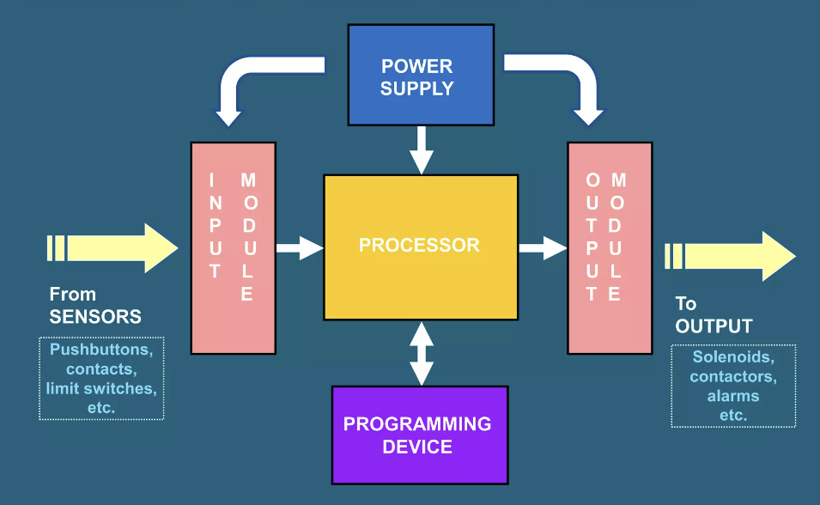
II.1.2 Explain PLC background
PLC Programming 1. AN INTRODUCTION TO PROGRAMABLE LOGIC CONTROLLERS
Notes:
PS: Provides the voltage needs to run the primary PLC components
I/O MODULES: Provides signal conversion and isolation between the internal logic-level signals inside the PLC and the field’s high level signal
PROCESSOR: Provides intelligence to command and govern the activities ò the entire PLC systems.
PROGRAM DEVICE: Used to enter the desired program that will determine the sequence of operation and control of process equipment or driven machine.

Slide 16
Historical Background:
In 1968, a group of engineers from General Motors developed the concept of PLC with an initial specification. The PLC must be:
i. Easy to program.
ii. Not need rewiring the control system if change the program.
iii. Smaller in size, cheaper and high reliability.
iv. simple construction and low maintenance
v. Cost- competitive
PLC Programming 1. AN INTRODUCTION TO PROGRAMABLE LOGIC CONTROLLERS

Slide 17
2.1.3 PLC functions
CONTROL TYPE: | FUNCTIONS
Sequence Control | Conventional Relay Control Logic replacer Timers/ Counter PCB Card controller replacer Auto/Semi-auto/Manual control of machine and process.
Advanced/ Sophisticated Control | Arithmetic operation (+, -, × , ÷) Information Handling Analog Control (Temperature, Pressure ) P.I.D (Proportional Integral Derivation) Servo Motor Control Stepper Motor control
PLC Programming 1. AN INTRODUCTION TO PROGRAMABLE LOGIC CONTROLLERS

Slide 18
PLC functions:
CONTROL TYPE: | FUNCTIONS
Supervisory Control | Process monitoring and alarm. Fault Diagnostic and monitoring Interfacing with Computer (RS-232C/RS 422) Printer/ ASCII Interfacing Factory Automation Networking Local Area Network (LAN) Wide Area Network (WAN) Factory Automation (F.A), Flexible Manufacturing System (F.M.S) & Computer Integrated Manufacturing (C.I.M).
PLC Programming 1. AN INTRODUCTION TO PROGRAMABLE LOGIC CONTROLLERS

Slide 19
PLC Size:
Small :
- it covers units with up to 128 I/O’s and memories up to 2 Kbytes.
- Capable of providing simple to advance levels or machine controls.
Medium :
- Have up to 2048 I/O’s and memories up to 32 Kbytes.
Large :
- The most sophisticated units of the PLC family. They have up to
8192 I/O and memories up to 750 Kbytes.
- Can control individual production processes or entire plant.
PLC Programming 1. AN INTRODUCTION TO PROGRAMABLE LOGIC CONTROLLERS

Slide 20
2.1.4 Types of PLC Construction:
Compact PLC
Modular PLC
PLC Plug-in Card
Manufacturer: OMRON, Allen Bradley, Mitsubishi, NAIS, Siemens, Toshiba, Festo etc.
PLC Programming 1. AN INTRODUCTION TO PROGRAMABLE LOGIC CONTROLLERS

Slide 21
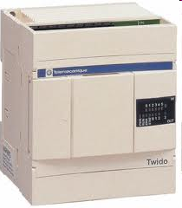
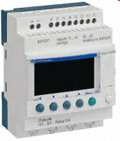
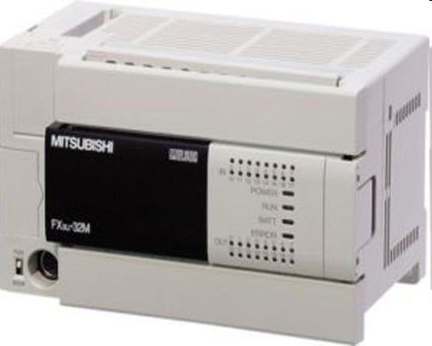
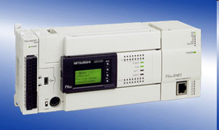
2.1.4 Types of PLC Construction:
i. Compact PLC:
Compact PLC – MELSEC FX3U
Figure 1: Compact PLC
PLC Programming 1. AN INTRODUCTION TO PROGRAMABLE LOGIC CONTROLLERS

Slide 22
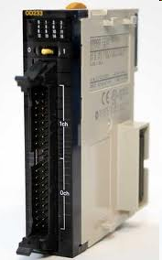
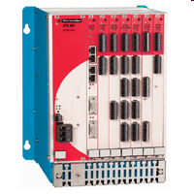
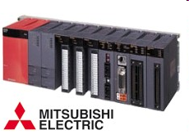
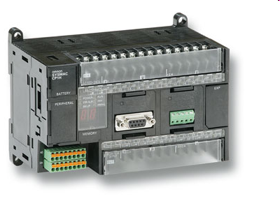
Modular PLC
Figure 2: Modular PLC
PLC Programming 1. AN INTRODUCTION TO PROGRAMABLE LOGIC CONTROLLERS

Slide 23
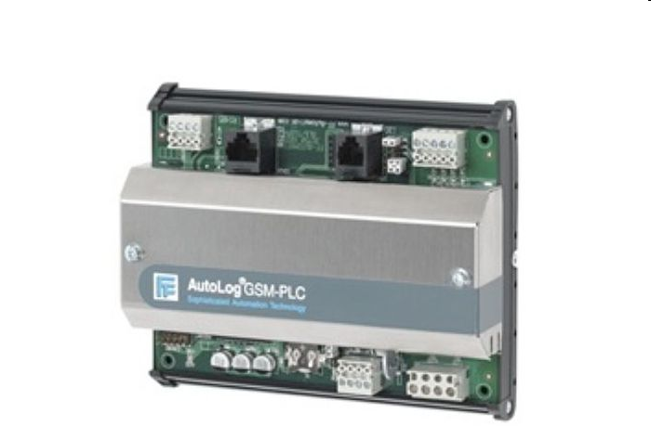
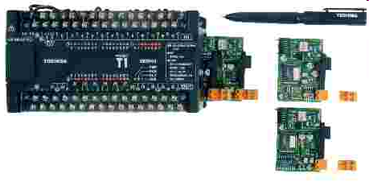
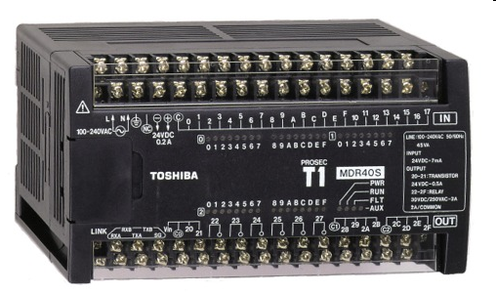
iii. PLC Plug-in Card
Figure 3: Plug-in Card PLC
PLC Programming 1. AN INTRODUCTION TO PROGRAMABLE LOGIC CONTROLLERS

Slide 24
PURPOSE OF Programmable
Logic Controllers (PLCs)
Initially designed to replace relay logic boards
  Sequence device actuation
  Coordinate activities
Accepts input from a series of switches
Sends output to devices or relays
Figure 3: Plug-in Card PLC
PLC Programming 1. AN INTRODUCTION TO PROGRAMABLE LOGIC CONTROLLERS

Slide 25
ADVANTAGES OF USING PLC:
Shorter project implementation time.
Easier modification
Project cost can be accurately calculated.
Shorter training time required.
Design easily changed using software ( changes and addition to specifications can be processed by software.
A wide range of control application
Easy maintenance.
High Reliability
Standardization of Controller hardware.
Able to withstand Harsh plant/process environments (Operate normally under severe conditions of temperature, humidity, voltage fluctuations and noises).
PLC Programming 1. AN INTRODUCTION TO PROGRAMABLE LOGIC CONTROLLERS

Slide 26
FUNCTIONS OF CONTROLLERS
1) on-off control,
2) sequential control,
3) feedback control, and
4) motion control.
PLC Programming 1. AN INTRODUCTION TO PROGRAMABLE LOGIC CONTROLLERS

Slide 27
Objectives
3.1.1 FUNCTION OF EACH BLOCK:
To define the basic components of a PLC
To apply PLC based control to a manufacturing system
To be identify instrumentation required to implement a PLC control system
To program a PLC
To implement a PLC control program and hardware
PLC Programming 1. AN INTRODUCTION TO PROGRAMABLE LOGIC CONTROLLERS

Slide 28
CONTROL DEVICES
1) mechanical control - cam, governor, etc.,
2) pneumatic control - compressed air, valves, etc.
3) electromechanical control - switches, relays, a timer, counters, etc,
4) electronics control - similar to electromechanical control, except uses electronic switches.
5) computer control.
PLC Programming 1. AN INTRODUCTION TO PROGRAMABLE LOGIC CONTROLLERS

Slide 29
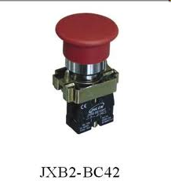
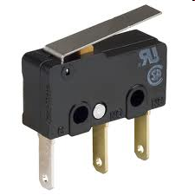
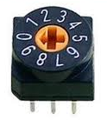
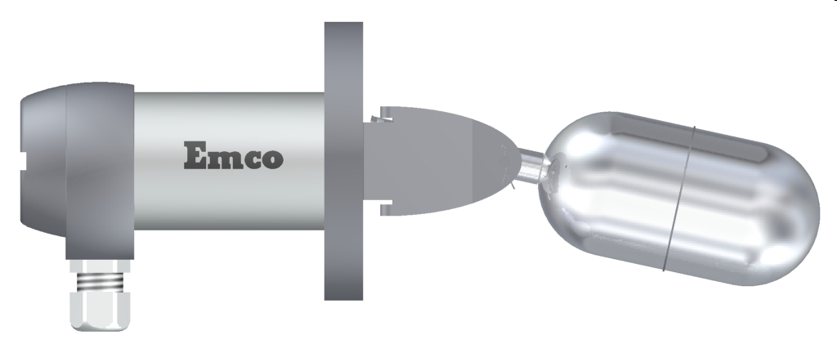
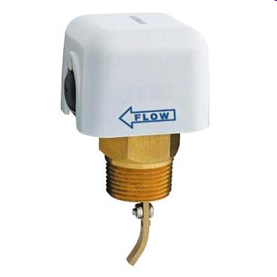
INPUT DEVICES:
Push Button
Limit Switch
Thumbwheel SW
Level SW
Flow SW
PLC Programming 1. AN INTRODUCTION TO PROGRAMABLE LOGIC CONTROLLERS

Slide 30
TYPES OF SWITCHES
1. Basic switch, operated by a mechanical level,
2. Push-button switch,
3. Slide switch,
4. Thumbwheel switch,
5. Limit switch,
6. Proximity switch, and
7. Photoelectric switch.
RATING: voltage, current
PLC Programming 1. AN INTRODUCTION TO PROGRAMABLE LOGIC CONTROLLERS

Slide 31
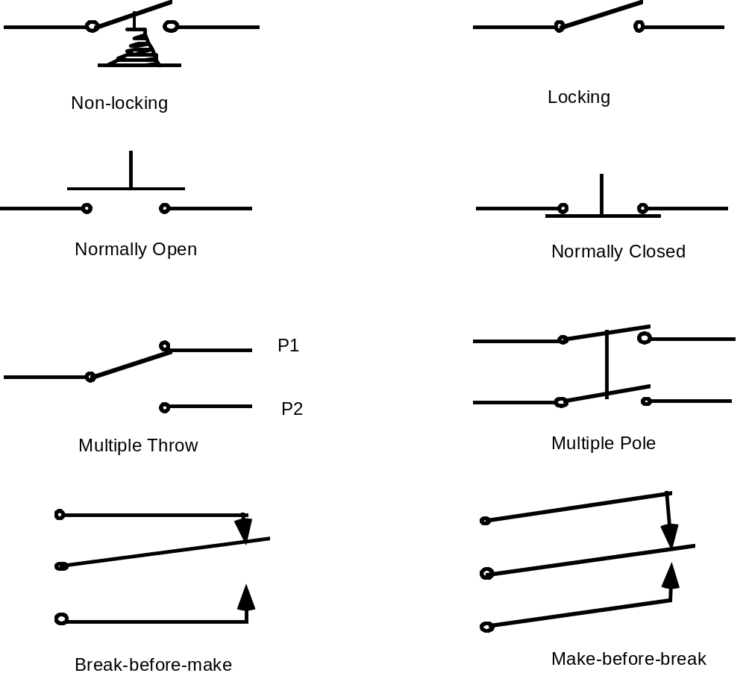
INPUT DEVICES:
SPDT
PLC Programming 1. AN INTRODUCTION TO PROGRAMABLE LOGIC CONTROLLERS

Slide 32
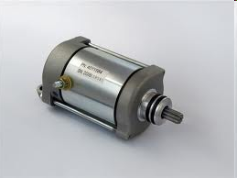
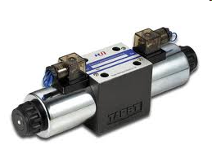
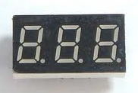
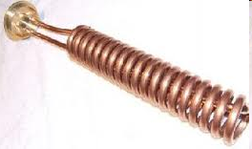
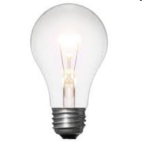
OUTPUT DEVICES:
Motor
Solenoid
LED Display
Heater Coil
Lamp
PLC Programming 1. AN INTRODUCTION TO PROGRAMABLE LOGIC CONTROLLERS

Slide 33
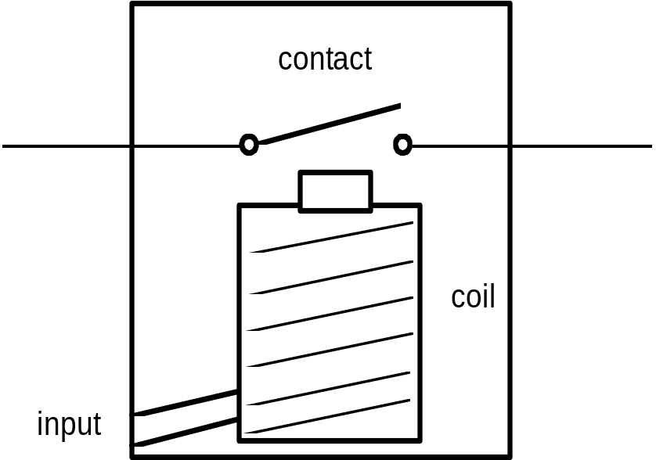

RELAYS
A switch whose operation is activated by an electromagnet is called a "relay"
Relay coil Output contact
PLC Programming 1. AN INTRODUCTION TO PROGRAMABLE LOGIC CONTROLLERS

Slide 34
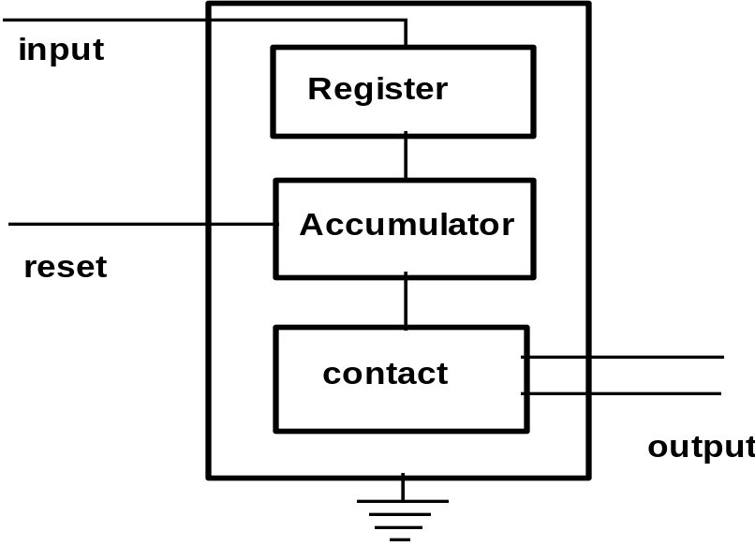
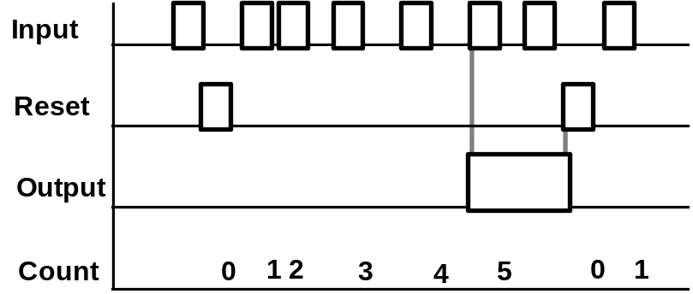
COUNTER
Digital counters output in the form of a relay contact when a preassigned count value is reached.
5
PLC Programming 1. AN INTRODUCTION TO PROGRAMABLE LOGIC CONTROLLERS

Slide 35
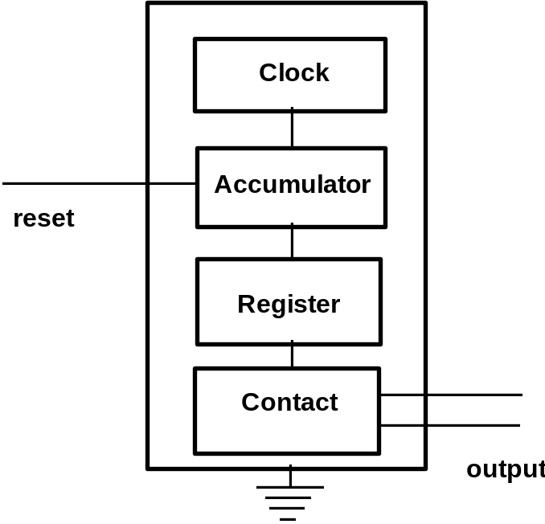
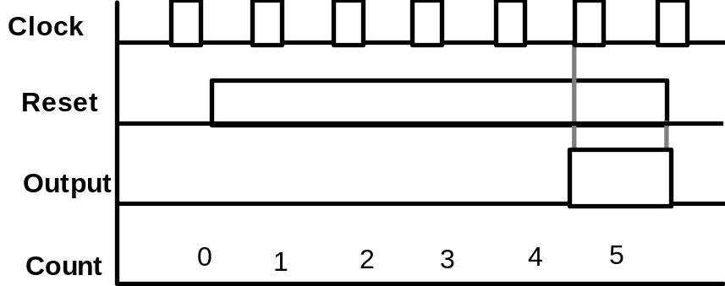
TIMER
A timer consists of an internal clock, a count value register, and an accumulator. It is used for or some timing purpose.
Time 5 seconds.
PLC Programming 1. AN INTRODUCTION TO PROGRAMABLE LOGIC CONTROLLERS

Slide 36
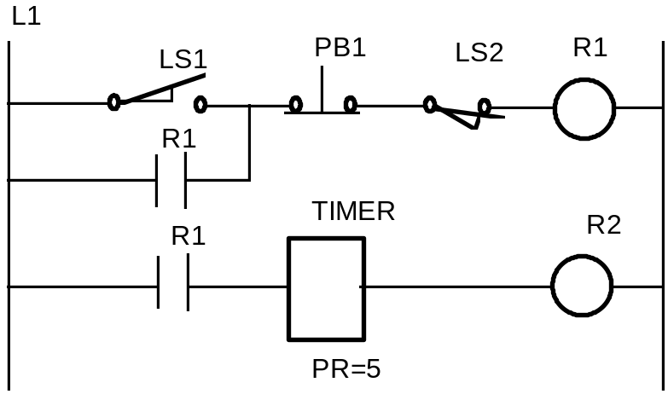
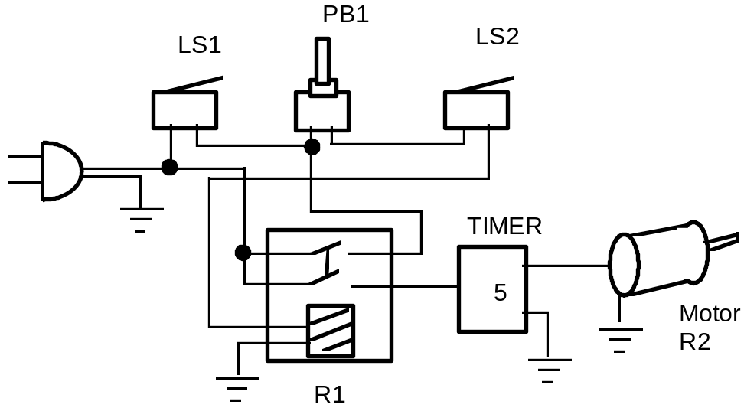
AN EXAMPLE OF RELAY LOGIC
For process control, it is desired to have the process start (by turning on a motor) five seconds after a part touches a limit switch. The process is terminated automatically when the finished part touches a second limit switch. An emergency switch will stop the process any time when it is pushed.
PLC Programming 1. AN INTRODUCTION TO PROGRAMABLE LOGIC CONTROLLERS

Slide 37
PLC HARDWARE DESIGN
PLC Programming 1. AN INTRODUCTION TO PROGRAMABLE LOGIC CONTROLLERS

Slide 38
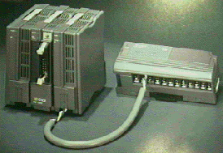
PLC
Input
CPU
Input
Module
Flag
System
Output
Module
Output
User Ladder
Diagram
Working
memory
registers
PLC Programming 1. AN INTRODUCTION TO PROGRAMABLE LOGIC CONTROLLERS

Slide 39
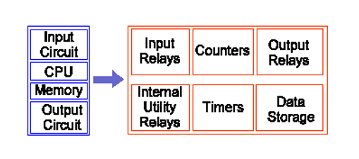
3.0 PLC HARDWARE DESIGN
3.1 Processor Architecture for PLC:
Data BUS
Microprocessor/ CPU
ROM
RAM
Input
Output
Address Bus
Control Bus
Figure 4: Design of Basic Microcomputer
PLC Programming 1. AN INTRODUCTION TO PROGRAMABLE LOGIC CONTROLLERS

Slide 40
3.1.1 FUNCTION OF EACH BLOCK:
Central Processing Unit (CPU)
The CPU controls, monitors and supervises all operations within PLC.
It is also caries out programmed instructions stored in the memory.
An internal communications highway also known as a bus system, carries information to and from the CPU, memory and I/O units under the control of the CPU.
PLC Programming 1. AN INTRODUCTION TO PROGRAMABLE LOGIC CONTROLLERS

Slide 41
3.1.1 FUNCTION OF EACH BLOCK:
Memory Unit
For storage of programs.
The user’s ladder logic program, the state of I/O in the memory of PLC.
The main program and the other programs necessary for the operation of PLC.
The organization of the data and information in the memory is called memory map.
2 types of Memory
RAM
ROM
PLC Programming 1. AN INTRODUCTION TO PROGRAMABLE LOGIC CONTROLLERS

Slide 42
TYPES OF MEMORY:
3.1.1 FUNCTION OF EACH BLOCK:
RAM Random Access Memory | ROM Read Only Memory (read)
This memory can be read from and written to. | This memory can be read only
Storing all user’s programs | Storing all system’s program
Entire contents will be lost if power is switched off. | Memory content remain when the power is switched off.
PLC Programming 1. AN INTRODUCTION TO PROGRAMABLE LOGIC CONTROLLERS

Slide 43
c. Input/ Output (I/O) Unit
3.1.1 FUNCTION OF EACH BLOCK:
Input Unit:
Function as a medium that connects the external input devices
(Switch, sensor & timer)
Output Unit:
Function as a medium that connects the external output devices to the CPU within PLC.
( Lamp, motor & solenoid )
PLC Programming 1. AN INTRODUCTION TO PROGRAMABLE LOGIC CONTROLLERS

Slide 44
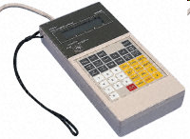
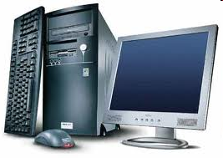
d. Display and Indicator Unit
Referring to PLC standard display Internal Relay:
Console’s LCD Display
if user use Mnemonic Code Programming.
Monitor Screen
if user use software programming method.
LCD Display
Monitor Screen
PLC Programming 1. AN INTRODUCTION TO PROGRAMABLE LOGIC CONTROLLERS

Slide 45
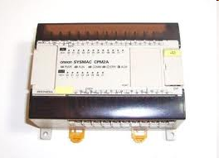
Housing Unit
Protect PLC circuit and internal component
Programming Unit
Consist of 2 devices:
i. Programming Console
ii. Computer
g. Secondary Storage Unit
This unit related to CPU where all program and information were kept.
PLC Programming 1. AN INTRODUCTION TO PROGRAMABLE LOGIC CONTROLLERS

Slide 46
h. Power Supply Unit:
Supplies DC power to the Central Processing Unit, Input Unit and Output Unit.
Printing Unit
Used to print control system programming that controlled by PLC wether graphically or text.

Slide 47
PLC Programming Languages
The standard IEC (International Electro technical Commission) was established to standardize the multiple languages associated with PLC programming by defining the following five standard languages:
• Ladder Diagram (LD) —a graphical depiction of a process with rungs of logic, similar to the relay ladder logic schemes that were replaced by PLCs
• Function Block Diagram (FBD) —a graphical depiction of process flow using simple and complex interconnecting blocks.
• Sequential Function Chart (SFC) —a graphical depiction of interconnecting steps, actions, and transitions.
• Instruction List (IL) —a low-level, text-based language that uses mnemonic instructions.
• Structured Text (ST) —a high-level, text-based language such as BASIC, C, or PASCAL specifically developed for industrial control applications
PLC Programming 1. AN INTRODUCTION TO PROGRAMABLE LOGIC CONTROLLERS

Slide 48
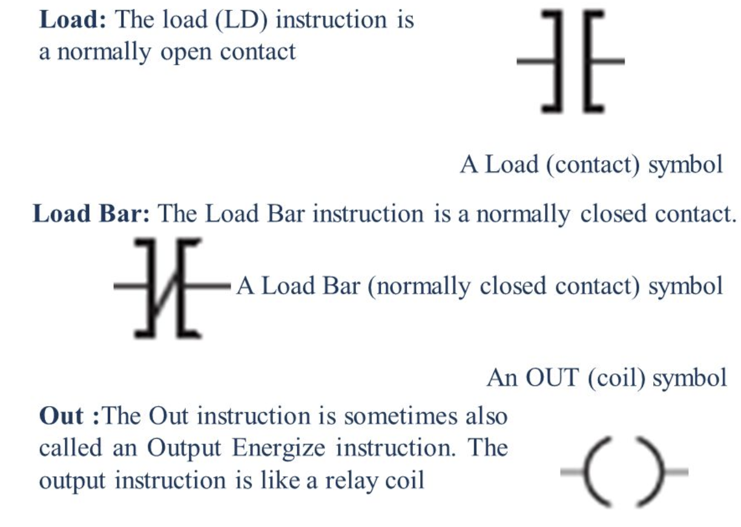
Ladder Diagram and Programming
PLC Programming 1. AN INTRODUCTION TO PROGRAMABLE LOGIC CONTROLLERS

Slide 49
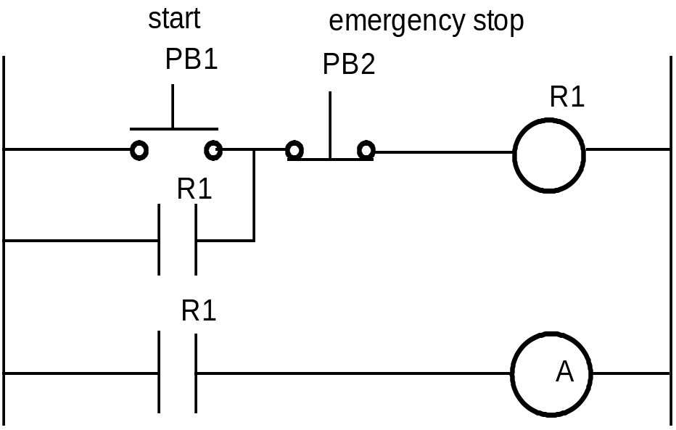
LADDER DIAGRAM
A ladder diagram (also called contact symbology) is a means of graphically representing the logic required in a relay logic system.
Rail
Rung

Slide 50
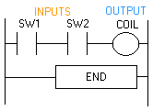
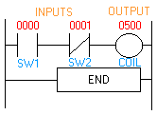
Ladder Representation

Slide 51
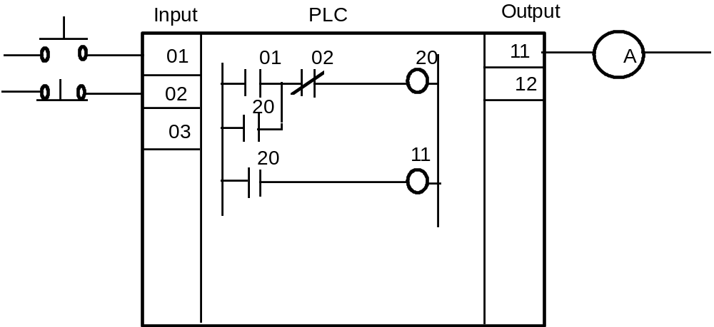
PLC WIRING DIAGRAM
External
switches
Stored program

Slide 52
SCAN
A PLC resolves the logic of a ladder diagram (program) rung by rung, from the top to the bottom. Usually, all the outputs are updated based on the status of the internal registers. Then the input states are checked and the corresponding input registers are updated. Only after the I/Os have been resolved, is the program then executed. This process is run in a endless cycle. The time it takes to finish one cycle is called the scan time.
Output
Input
begin
Idle
Scan cycle
Resolve
logic

Slide 53
PLC INSTRUCTIONS
1) Relay,
2) Timer and counter,
3) Program control,
4) Arithmetic,
5) Data manipulation,
6) Data transfer, and
7) Others, such as sequencers.

Slide 54
LOGIC STATES
ON : TRUE, contact closure, energize, etc.
OFF: FALSE, contact open , de-energize, etc.
Do not confuse the internal relay and program with the external
switch and relay. Internal symbols are used for programming.
External devices provide actual interface.
(In the notes we use the symbol "~" to represent negation. AND and OR are logic operators. )

Slide 55
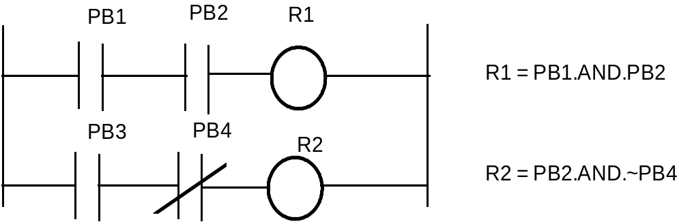
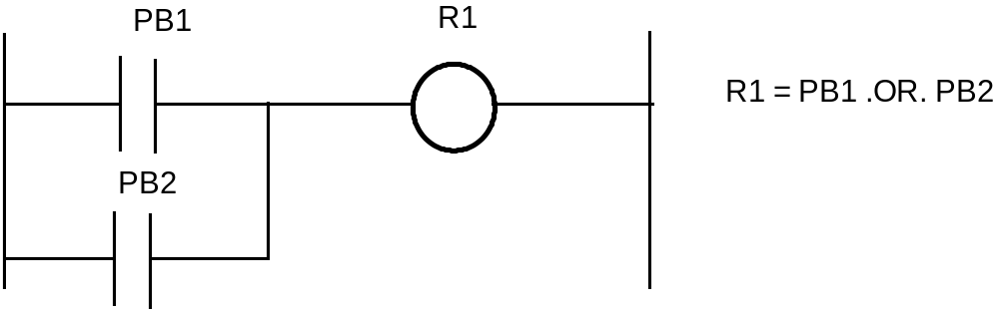
AND and OR LOGIC
AND GATE
PB1 | PB2 | Logic (R)
ON | ON | ON
ON | OFF | OFF
OFF | ON | OFF
OFF | OFF | OFF
OR GATE
PB1 | PB2 | Logic (R1)
ON | ON | ON
Notes:
Lập bảng với cổng NOR Gate và NAND Gate

Slide 56
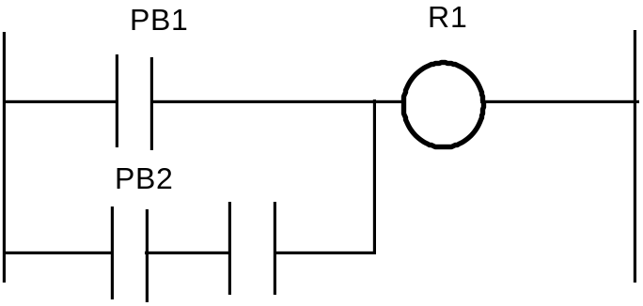
COMBINED AND & OR
R1 = PB1 .OR. (PB2 .AND. PB3)
pb3

Slide 57
RELAY
A Relay consists of two parts, the coil and the contact(s).
Contacts:
a. Normally open -| |-
b. Normally closed -|/|-
c. Off-on transitional -|↑|-
d. On-off transitional -|↓ |-
Coil:
a. Energize Coil -( )-
b. De-energize -(/)-
c. Latch -(L)-
d. Unlatch -(U)-
( )

Slide 58
TIMERS AND COUNTERS
Input
True False True
Timers:
a. Retentive on delay -(RTO)-
b. Retentive off delay -(RTF)-
c. Reset -(RST)-
Counter:
a. Counter up -(CTU)-
b. Counter down -(CTD)-
c. Counter reset -(CTR)-
RTO counting stop counting
resume
RTF stop counting stop
RTO reach PR value, output ON
RTF reach PR value, output OFF
PR value in 0.1 second

Slide 59
SEQUENCER
Sequencers are used with machines or processes involving repeating operating cycles which can be segmented into steps.
Output
Step A B C Dwell time
1 ON OFF OFF 5 sec.
2 ON ON OFF 10 sec.
3 OFF OFF ON 3 sec.
4 OFF ON OFF 9 sec.

Slide 60
Rockwell/ Allen Bradley PLC
I/O points are numbered, they correspond to the I/O slot on the PLC.
For A-B controller used in our lab
I/O uses 1-32
Internal relays use 033 - 098
Internal timers/counters/sequencers use 901-932
Status 951-982

Slide 61
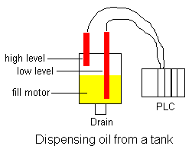
Programming a PLC
Oil is consumed randomly. The tank needs to be refilled by turning on a pump. Two hydrostatic switches are used to detect a high and low level.

Slide 62
Programming a PLC
Write a PLC Program to Control 2 Pumps:
The system includes 3 level sensors: High level, Middle level, and Low level.
When the pump is empty, all 3 sensors (High, Middle, and Low) are ON, and both Motors 1 and 2 turn ON.
As the water level reaches the Low-level sensor, the Low-level sensor turns OFF.
When the water level reaches the Middle-level sensor, the Middle-level sensor turns OFF. At this point, if both the Low-level and Middle-level sensors are OFF, Motor 1 stops, but Motor 2 continues running.
When the water reaches the High-level sensor, all 3 sensors (High, Middle, and Low) turn OFF, and both motors stop.

Slide 63
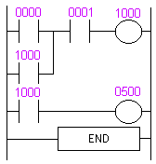
Ladder Logic for Tank

Slide 64
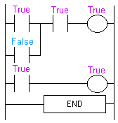
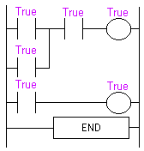
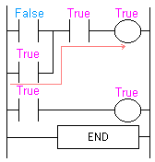



Logic for Ladder Solution

Slide 65

How does it work?

